Slide 1

FUNDAMENTALS OF BLOCKCHAIN TECHNOLOGY
PRESENTED BY,
D. JANET RAMYA MCA. ,
RESEARCH SCHOLAR,
DEPT. OF COMPUTER SCIENCE,
ST.JOSEPH’S COLLEGE, TRICHY - 2.

Slide 2
CONTENTS
Gartner’s Hype Cycle
Cryptographic primitives
Cryptocurrencies
Centralised vs. Decentralised vs. Distributed Networks
Blockchain 1.0, 2.0, 3.0,4.0…
Blockchain Structure
Features of Blockchain
The Blockchain Model
Consensus – PoW, PoS
Types of Blockchain – Public, Private, Consortium
Blockchain Platforms – Ethereum, Hyperledger
Pros & Cons
Applications in Daily Life
Tools
Facts
What’s on the NEWS ??
Job Opportunities – Where to Start?

Slide 3
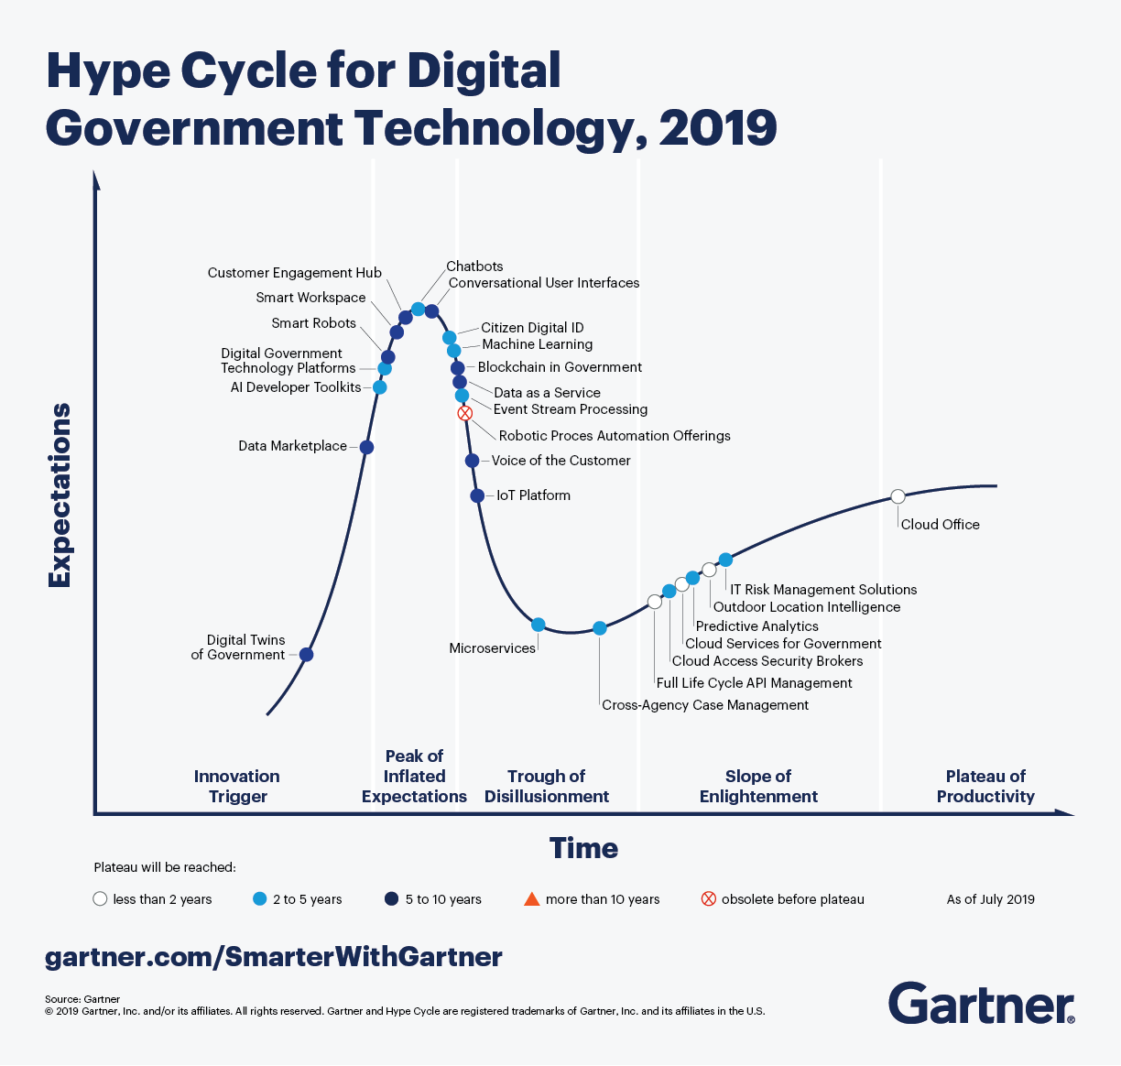
Gartner’s Hype Cycle - 2019

Slide 4
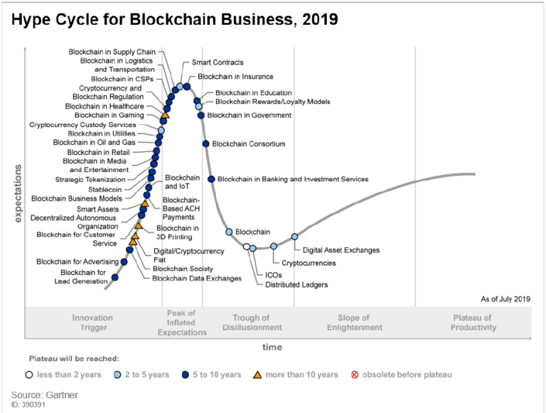

Slide 5
Cryptographic Primitives
Symmetric & Asymmetric Cryptosystem
Hash Function
Digital Signatures

Slide 6
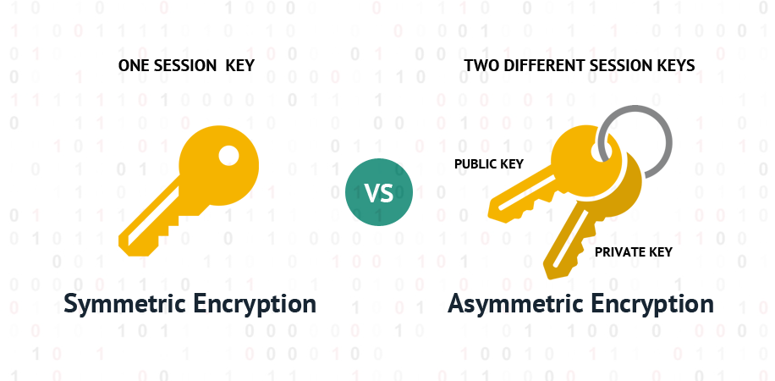

Slide 7
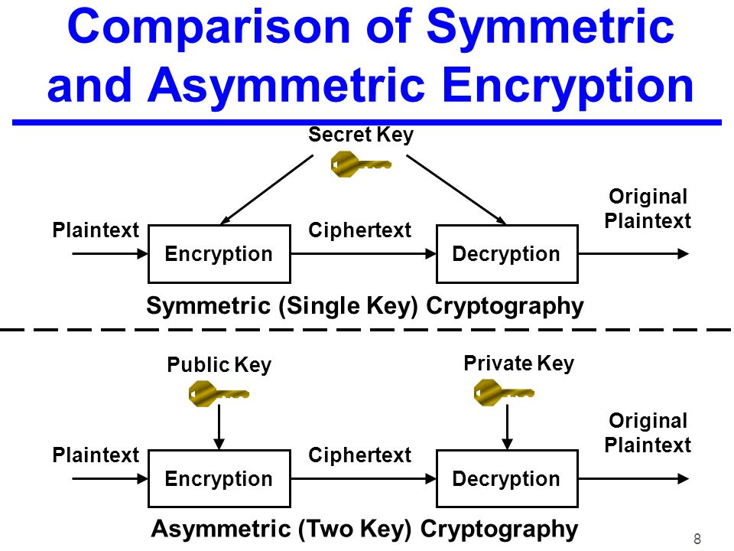

Slide 8
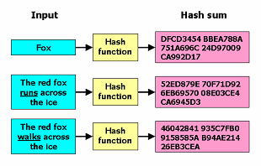
Hash Function
https://passwordsgenerator.net/sha256-hash-generator/

Slide 9
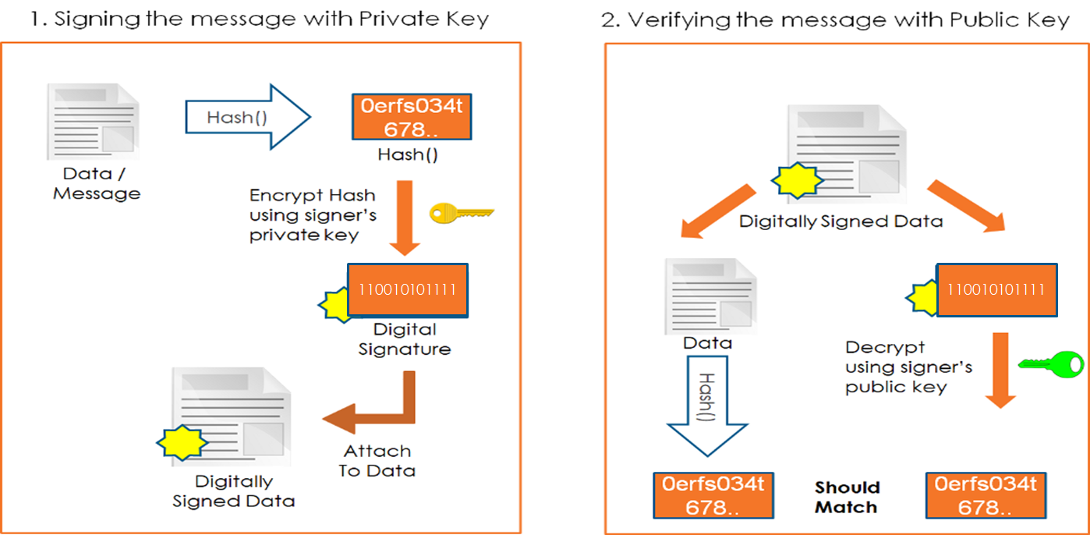
Digital Signature
A digital signature is a mathematical scheme for presenting the authenticity of digital messages or documents. - Fingerprint
https://www.bitaddress.org/bitaddress.org-v3.3.0-SHA256-dec17c07685e1870960903d8f58090475b25af946fe95a734f88408cef4aa194.html
https://blockstream.info/address/1Bhd2VENpcok56VqUmYKBDECj3AZvgsFTA

Slide 10
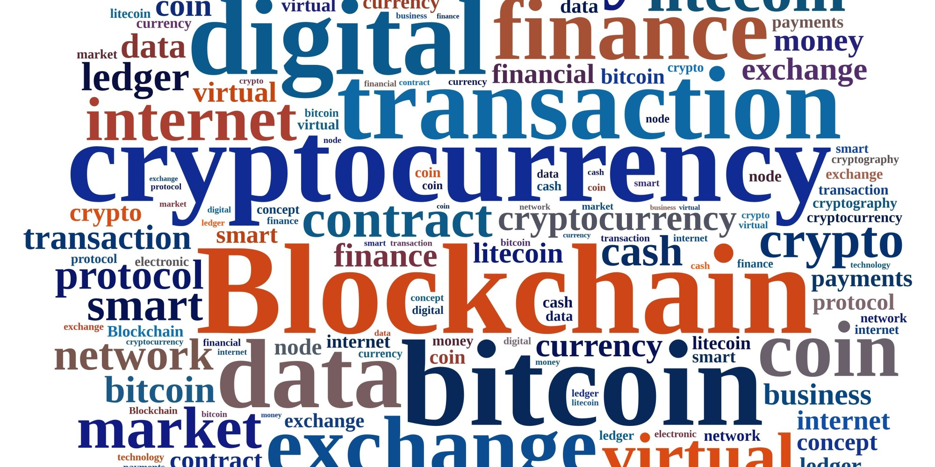
DO YOU KNOW ????

Slide 11
HISTORY
A Peer-to-Peer Electronic Cash System
With the invention of Bitcoin, Blockchain came into recognition and then was implemented in 2009.
Satoshi Nakamato found and implemented it as a core component of Bitcoin.
Current value of 1 BTC = 7,19,070.45 INR

Slide 12
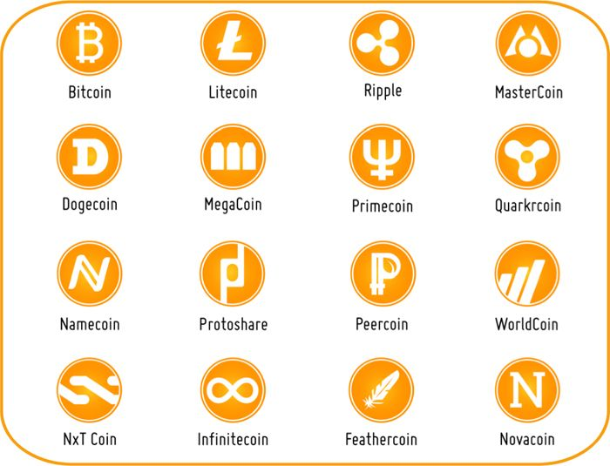
CRYPTOCURRENCIES

Slide 13
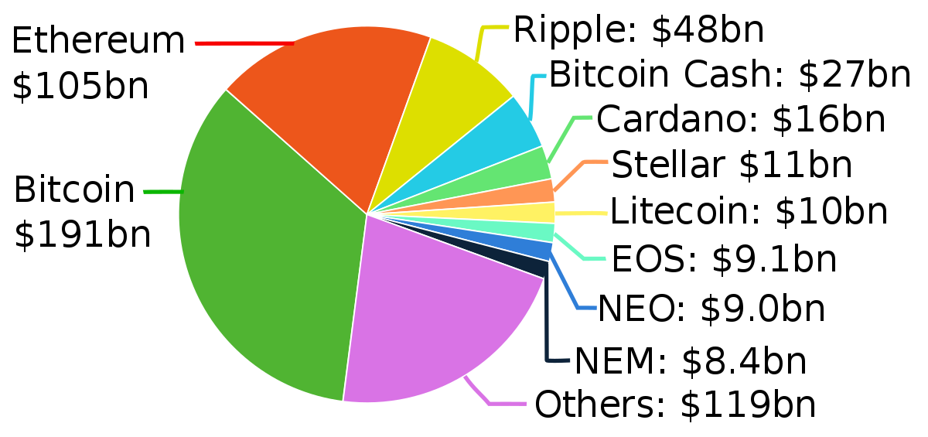
POPULAR CRYPTOCURRENCIES

Slide 14
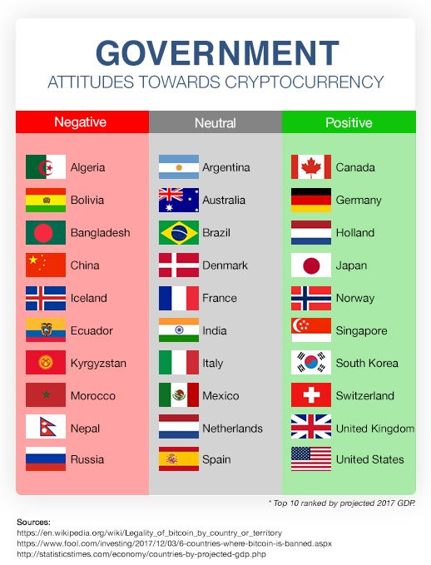

Slide 15
WHY BITCOIN??
First digital money which solved the problem of double spending
Decentralized, Distributed,P2P Network
Runs on Blockchain Technology

Slide 16

DOUBLE SPENDING PROBLEM

Slide 17
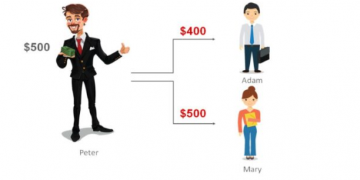
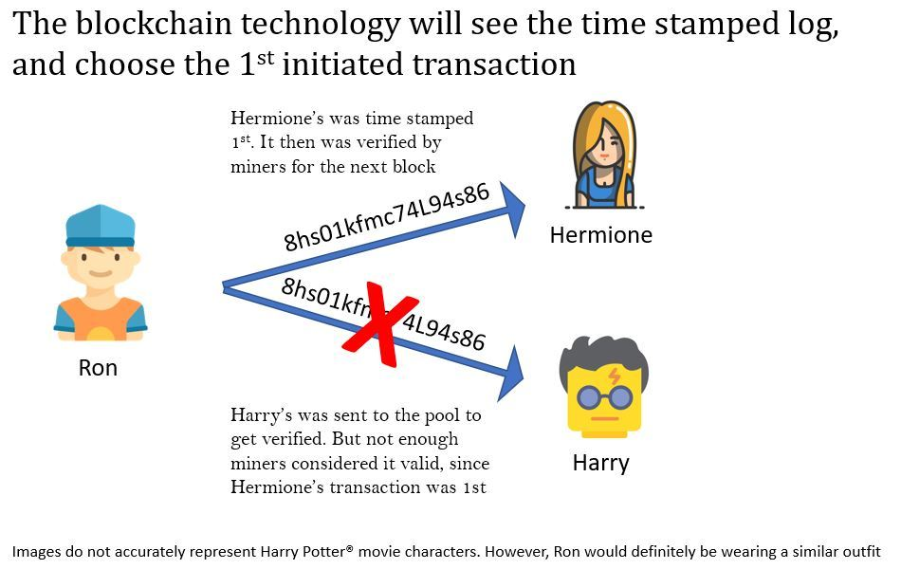
DOUBLE SPENDING PROBLEM

Slide 18
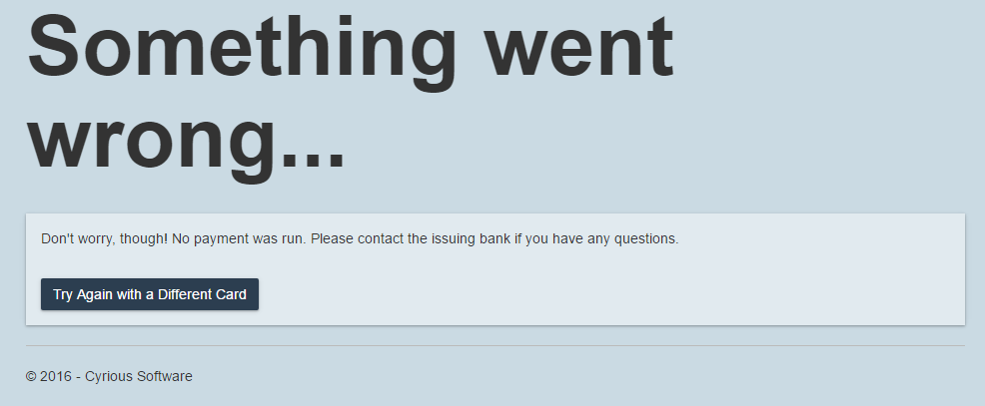
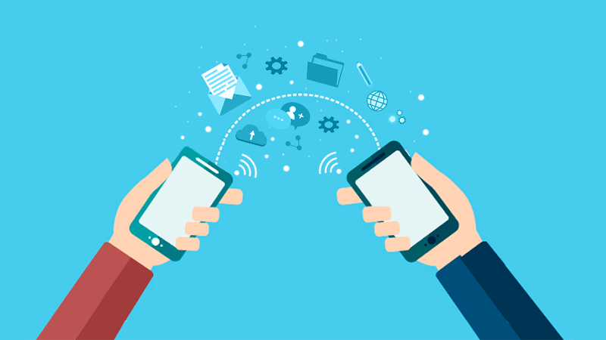
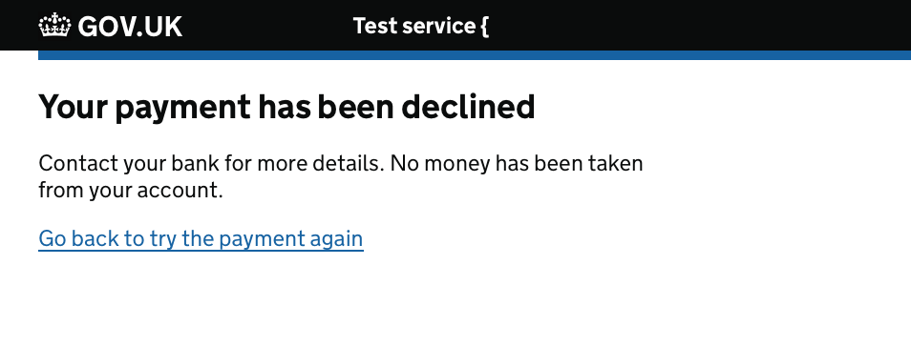
DECENTRALIZATION

Slide 19
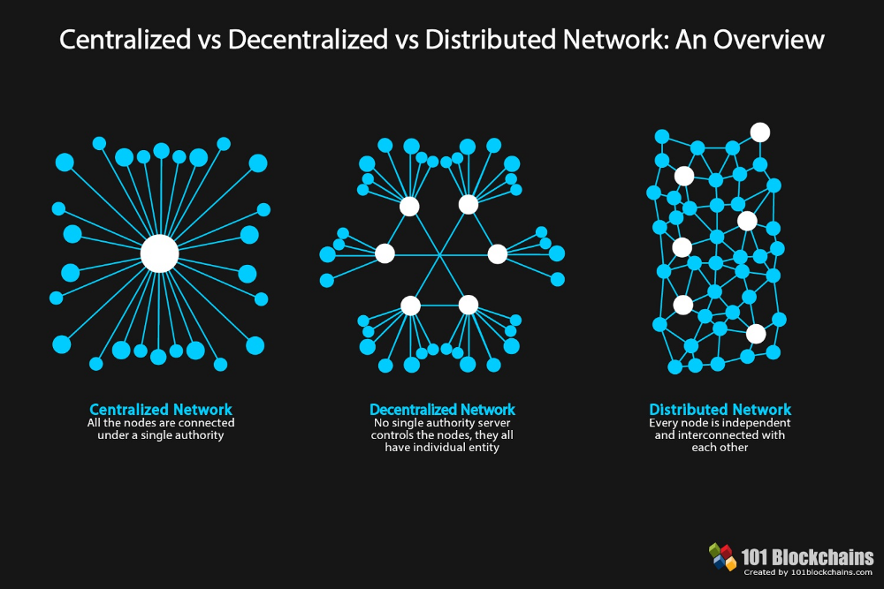

Slide 20

What????
What is blockchain?
What is bitcoin?
What is the difference between bitcoin and blockchain?
Why is there so much hype around this concept?

Slide 21
BLOCKCHAIN
Decentralized Distributed Public Ledgers (aka Blockchain) that is used to record transactions across many computers.
The blockchain is an incorruptible digital ledger of economic transactions
Records not just financial transactions but everything of value

Slide 22
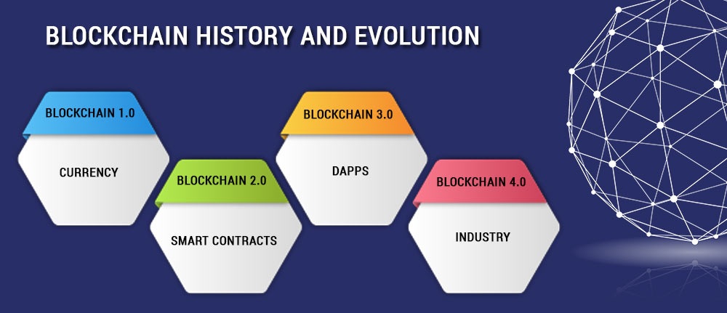

Slide 23
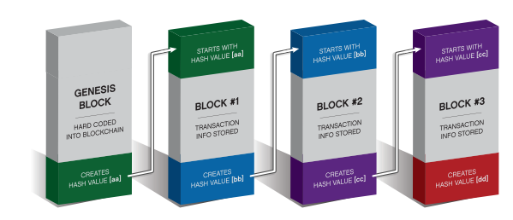
BLOCKCHAIN STRUCTURE

Slide 24
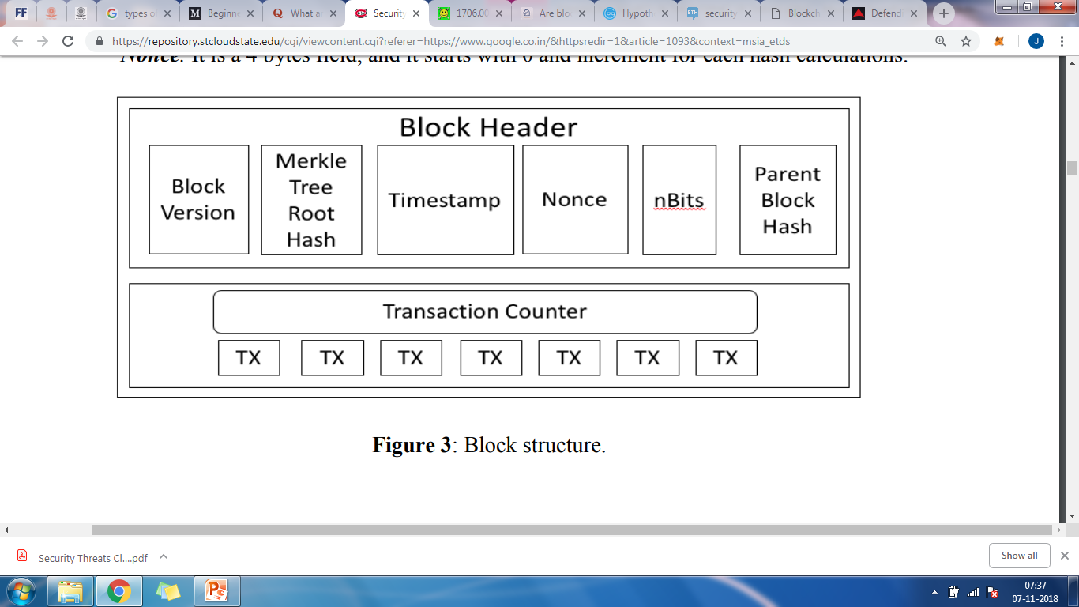
BLOCK HEADER

Slide 25
BLOCK HEADER
There are six elements in a block header;
Parent block hash - It's a 256-bit hash of the previous block header, and it is 32 bytes in size, and it's updated when a new block comes into the blockchain.
Block Version - It is 4 bytes in size that indicates the block version number
Merkle tree root hash -A 256-bit hash based on all the transactions in the block, and it is updated when a transaction is accepted, and it's 32 bytes in size.
nBits- It is 4 bytes in size, and it's a target threshold of a valid block hash, in other words, it is the answer to a difficult-to-solve mathematical puzzle that solved by miners to validate the block
Timestamp - Current time as seconds in the universal time, and it takes 4 bytes in size of block header
Nonce - It is a 4 bytes field, and it starts with 0 and increment for each hash calculations.

Slide 26
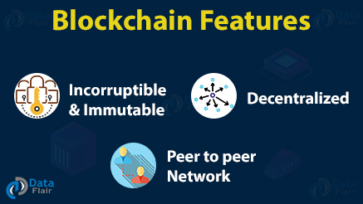

Slide 27
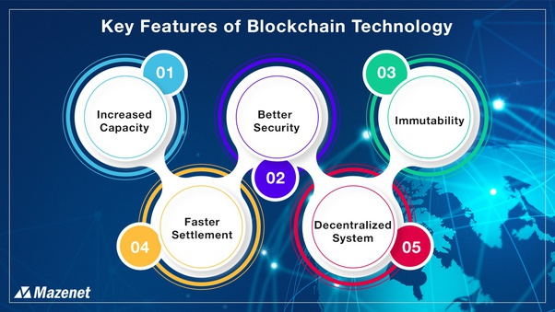
Increased Capacity: It increases the capacity of the whole network
Better Security: Nodes confirm the transaction on this network
Immutability: Write once, read many
Faster Settlement: Settles money transfer at really fast speed
Decentralized System: owner has a direct control over his account and assets

Slide 28
THE BLOCKCHAIN MODEL
Blockchain is a database that maintains a continuously growing set of data records, called Blocks, which are linked using Cryptography.
It is distributed in nature, meaning that there is no master computer holding the entire chain.
The participating nodes have a copy of the chain.

Slide 29
WORKING
‘Consensus’ means that the nodes on the network agree on the same state of a blockchain, in a sense making it a self-auditing ecosystem.
When someone wants to add a transaction to the chain, all the participants in the network will validate it.
They do this by applying an algorithm to the transaction to verify its validity.
Then it is up to a majority of the participants to agree that the transaction is valid.
A set of approved transactions is then bundled in a block, which gets sent to all the nodes in the network. They, in turn, validate the new block.
Each successive block contain a hash, which is a unique fingerprint, of the previous block.

Slide 30
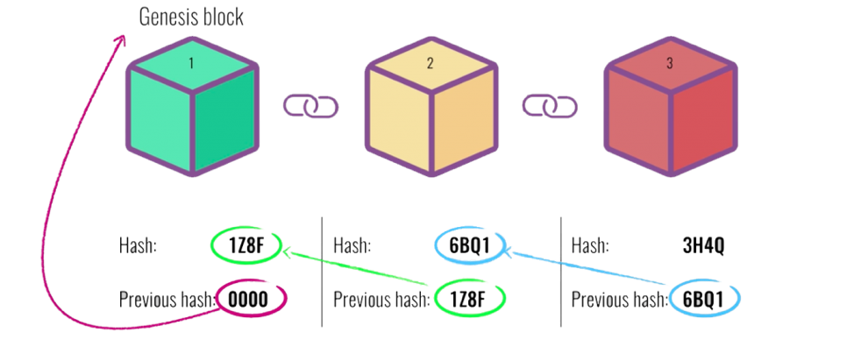
The Genesis Block
The Genesis Block – first block of the blockchain usually numbered 0.
The previous hash field of this block is 00000000000.

Slide 31
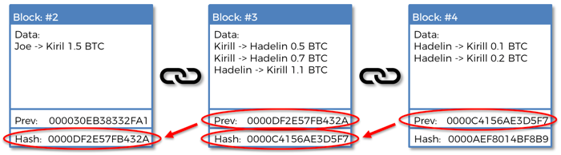
MINING
Each block contains a SHA-256 cryptographic hash of the previous block.
Miners keep the blockchain consistent, complete, and unalterable by repeatedly grouping newly broadcast transactions into a block, which is then broadcast to the network and verified by recipient nodes.

Slide 32
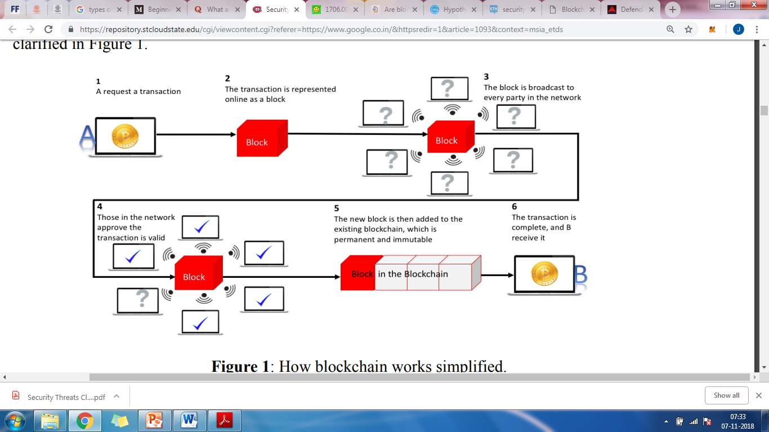
FORMING A CHAIN

Slide 33
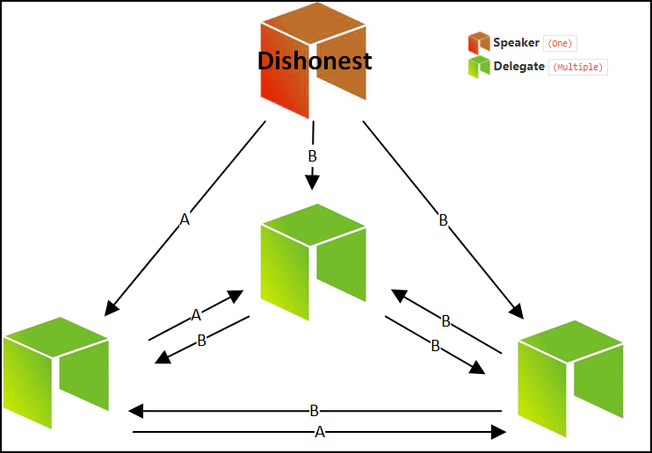
CONSENSUS MECHANISM
Consensus protocols- set of rules that decide how a blockchain agrees to adding a new block.

Slide 34

PROOF OF WORK -PoW

Slide 35
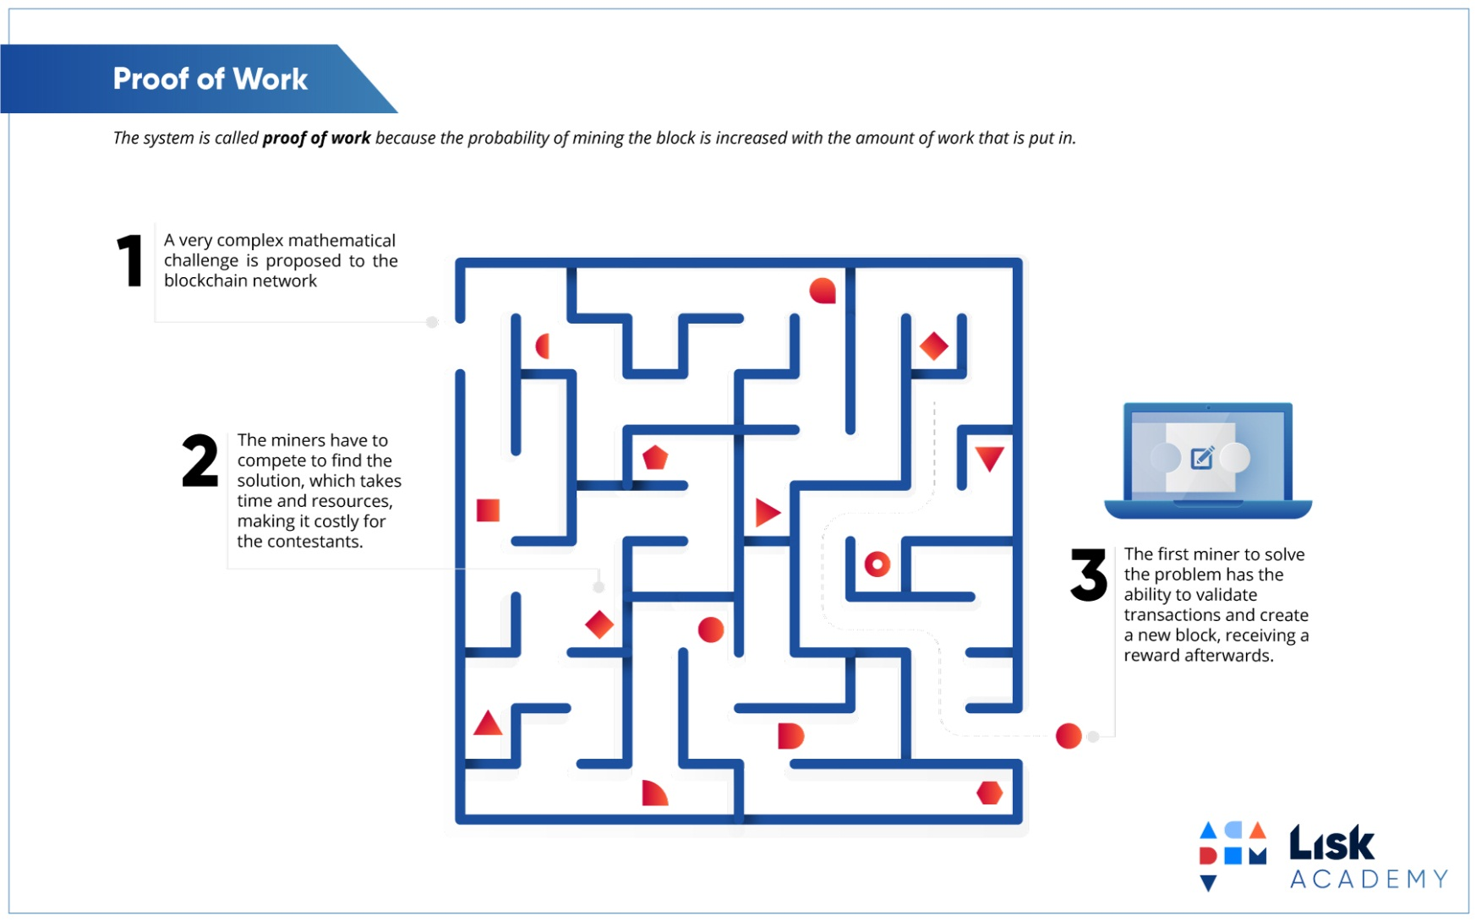

Slide 36
WORKING
Transactions are bundled together into what we call a block
Miners verify that transactions within each block are legitimate
To do so, miners should solve a mathematical puzzle known as proof-of-work problem
A reward is given to the first miner who solves each blocks problem
Verified transactions are stored in the public blockchain

Slide 37
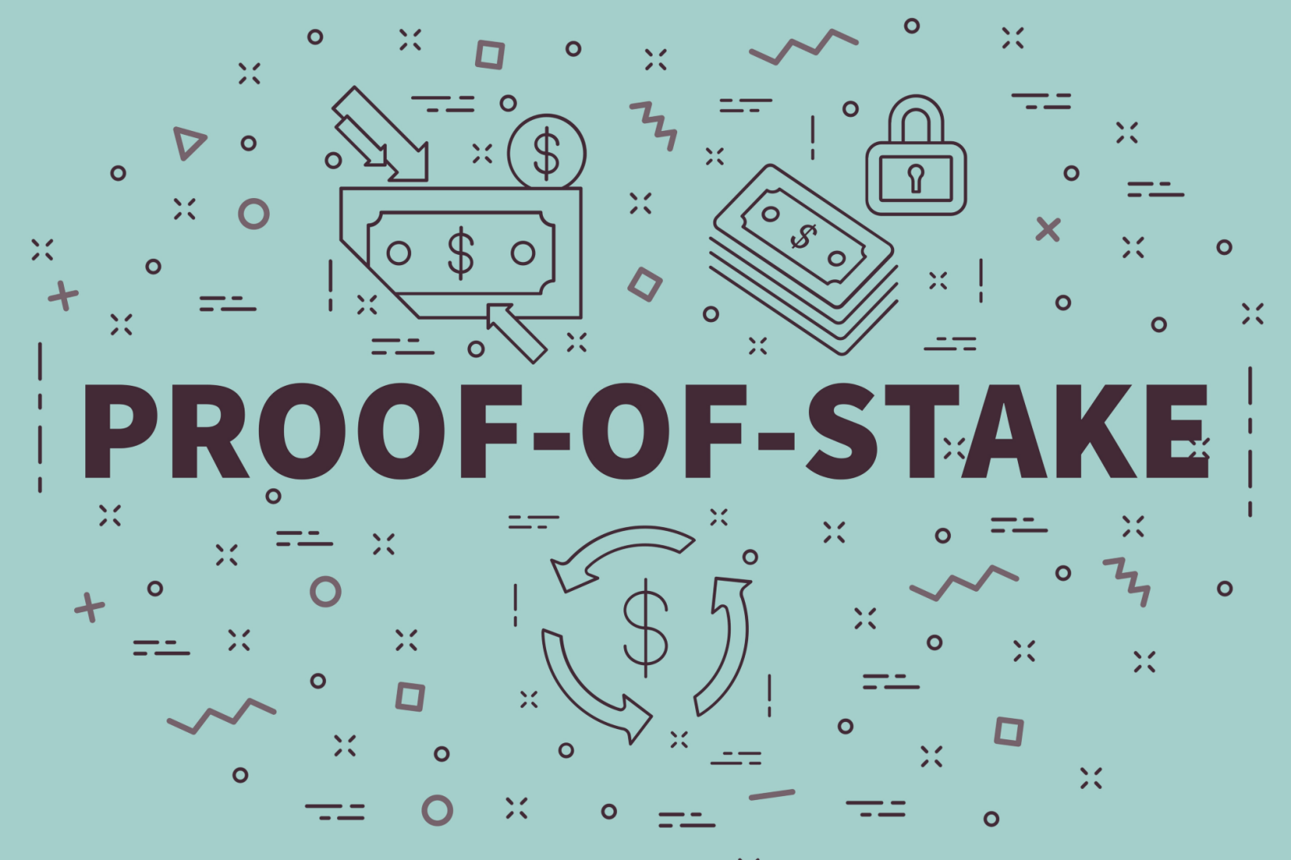

Slide 38
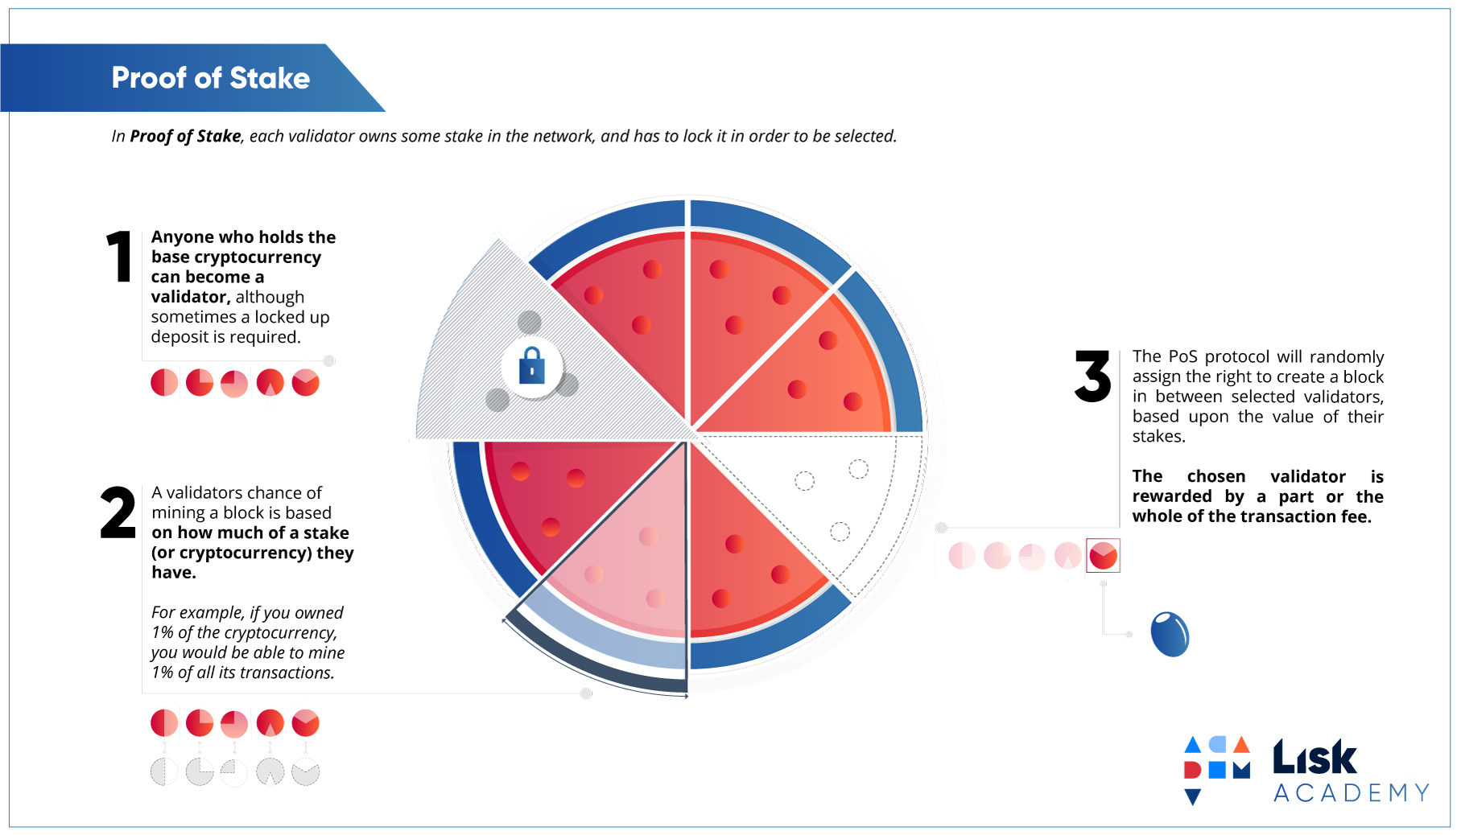

Slide 39
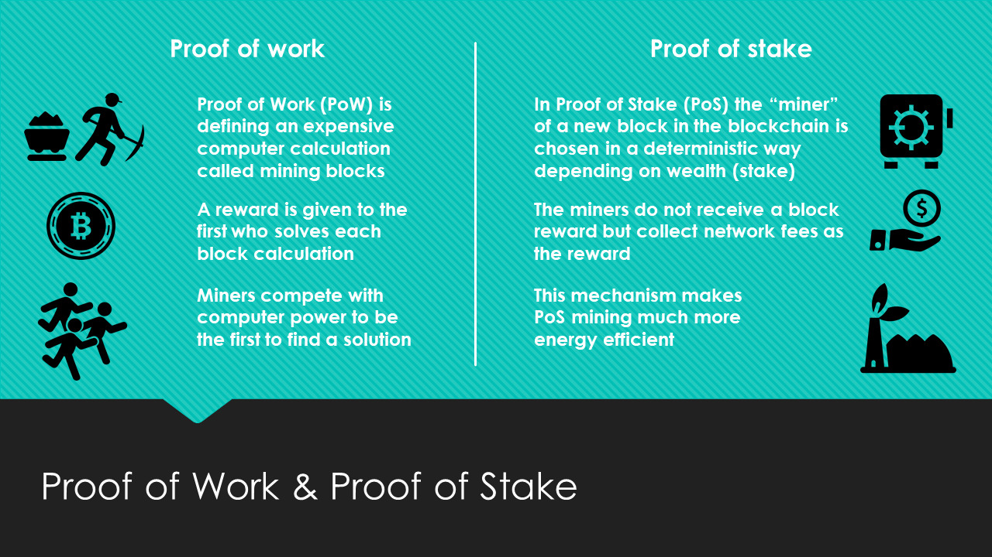

Slide 40
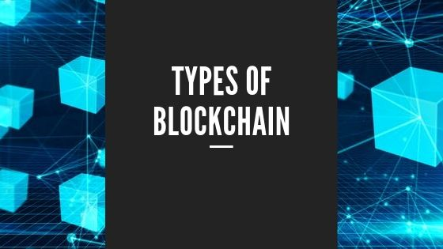

Slide 41
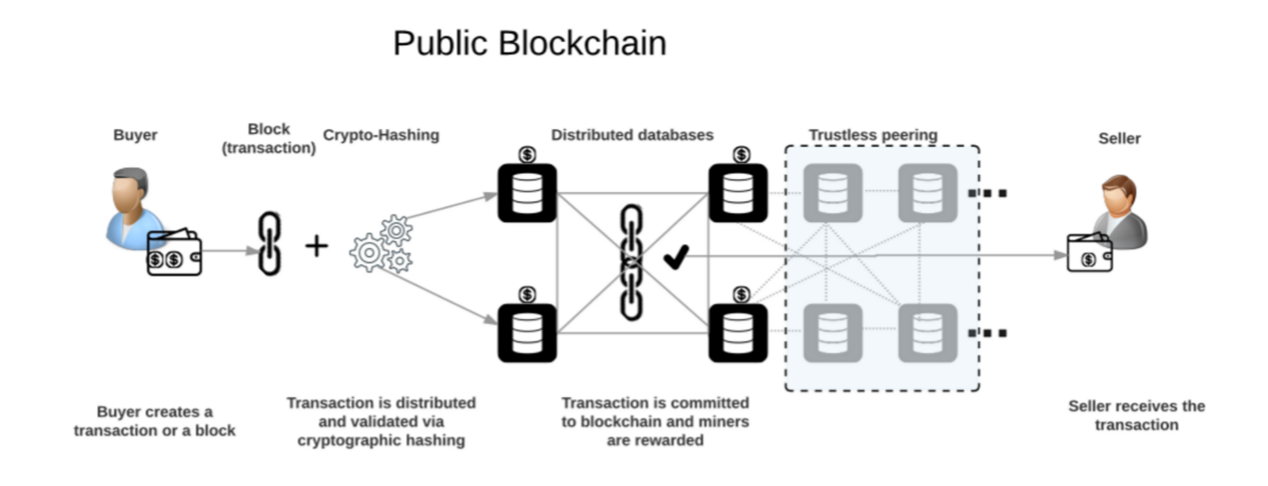
Public blockchains – Permission-less BC
A public blockchain has absolutely no access restrictions.
Anyone with an internet connection can send transactions to it as well as become a validator
Eg:- Bitcoin, Ethereum, Litecoin.

Slide 42
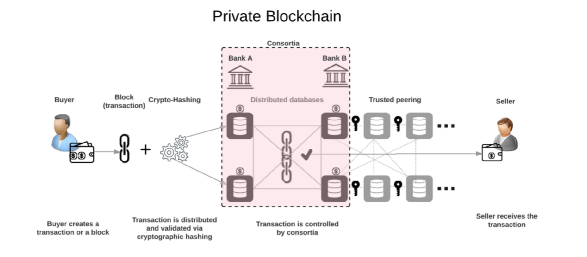
Private blockchains – Permissioned BC
One cannot join it unless invited by the network administrators
Participant and validator access is restricted.
Eg:- Multichain, Hyperledger

Slide 43
Consortium blockchain
A consortium blockchain is often said to be semi-decentralized
Permissioned but instead a single organization is controlling it
The administrators of a consortium chain restrict users' reading rights and only allow a limited set of trusted nodes to execute a consensus protocol
Eg: Energy Web Foundation, R3

Slide 44
Hybrid blockchain
A hybrid blockchain is a combination of the private and public blockchain
It uses the features of both types of blockchains that is one can have a private permission-based system as well as a public permission-less system
Only a selected section of data or records from the blockchain can be allowed to go public keeping the rest as confidential in the private network.
Eg: Dragonchain

Slide 45
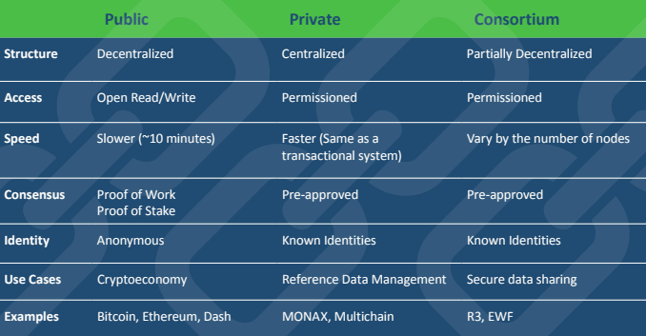

Slide 46
Blockchain Platforms

Slide 47
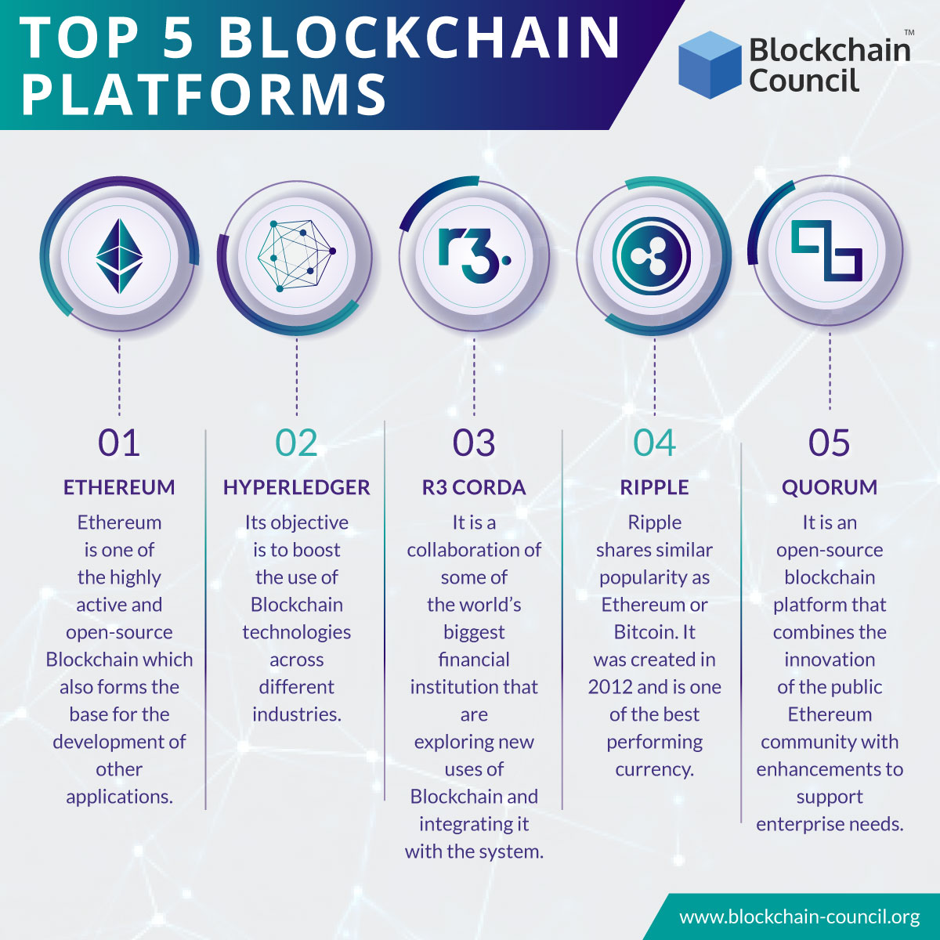

Slide 48
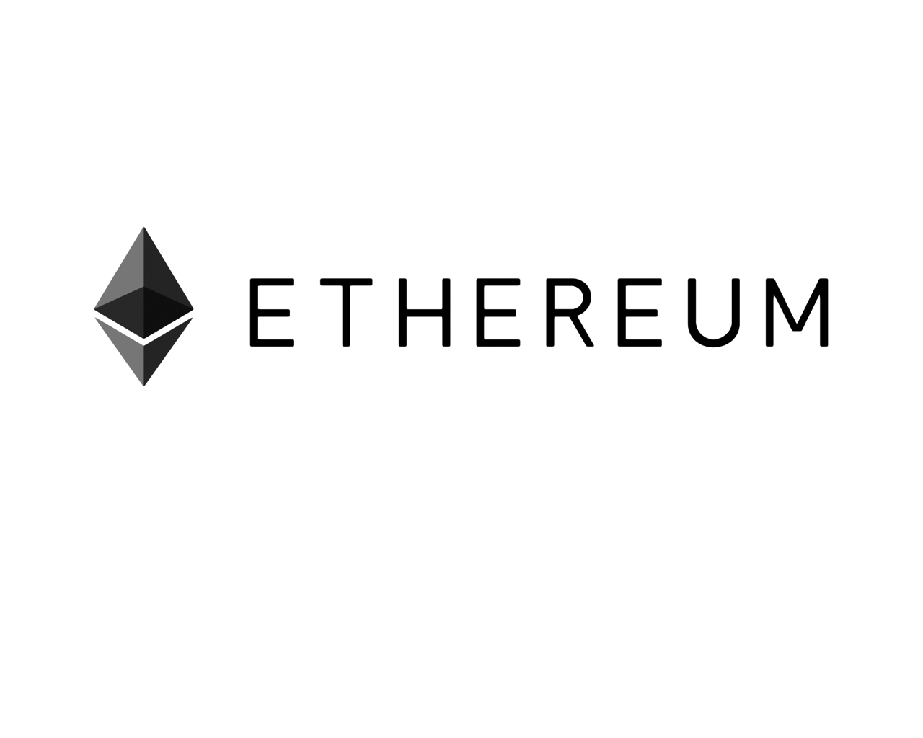

Slide 49

Ethereum
Creator/Developer - Vitalik Buterin
Launched in 2013, Ethereum is the world’s leading programmable blockchain (At the age of 19)
Ethereum has a native cryptocurrency called Ether (ETH)
Ethereum is programmable, which means that developers can use it to build new kinds of applications and blockchain projects.
Decentralized applications (or “dapps”) gain the benefits of cryptocurrency and blockchain technology
https://www.stateofthedapps.com/rankings/platform/ethereum

Slide 50
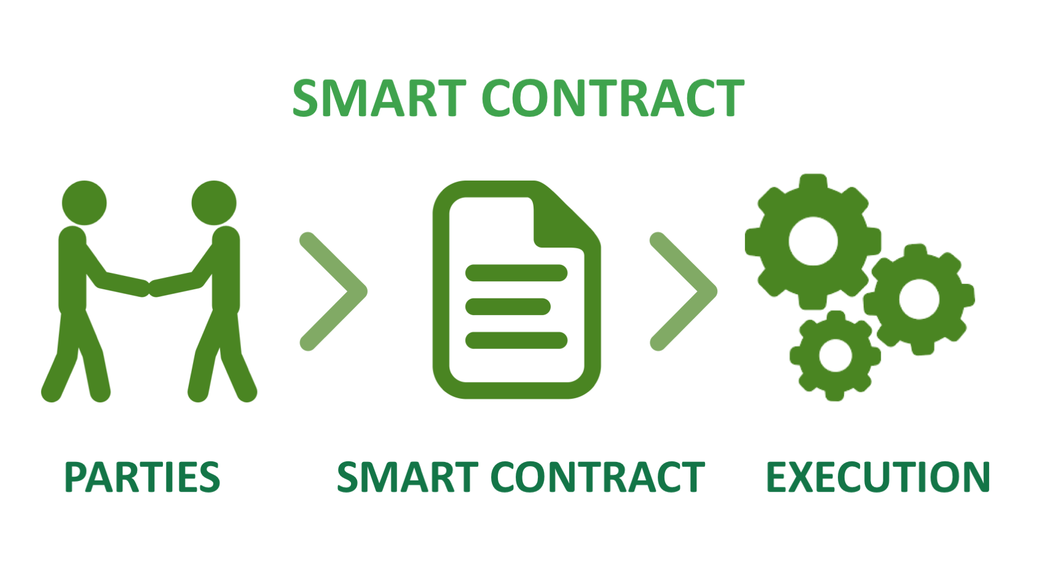

Slide 51
SMART CONTRACTS
Smart contracts were first proposed by Nick Szabo, who coined the term
A smart contract is a computer protocol intended to digitally facilitate, verify, or enforce the negotiation or performance of a contract
Smart contracts allow the performance of credible transactions without third parties. These transactions are traceable and irreversible
They are self verifying, tamper resistant

Slide 52
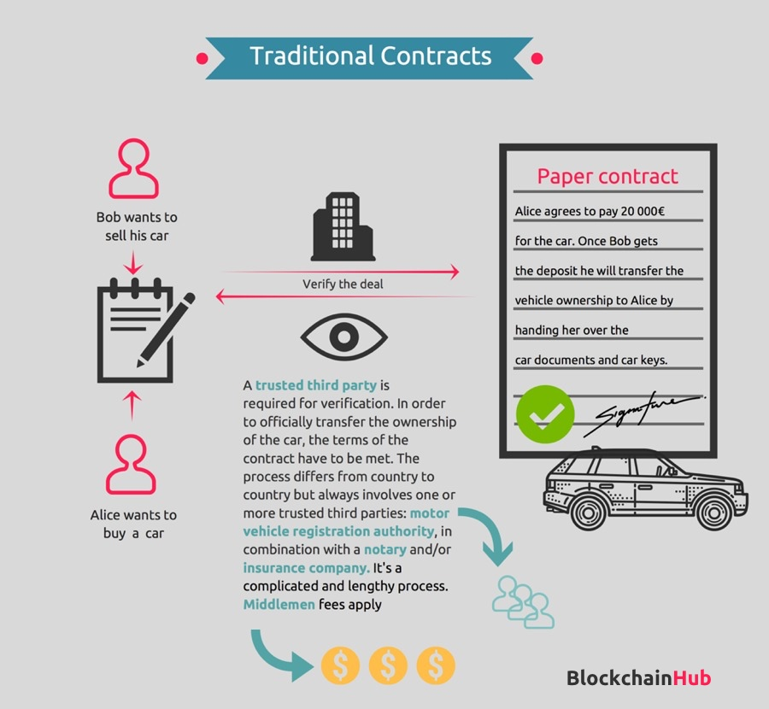

Slide 53
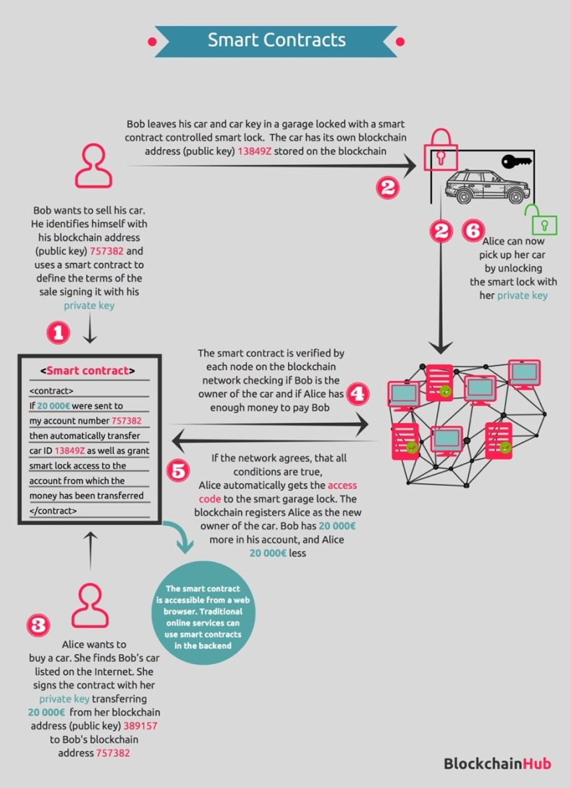

Slide 54
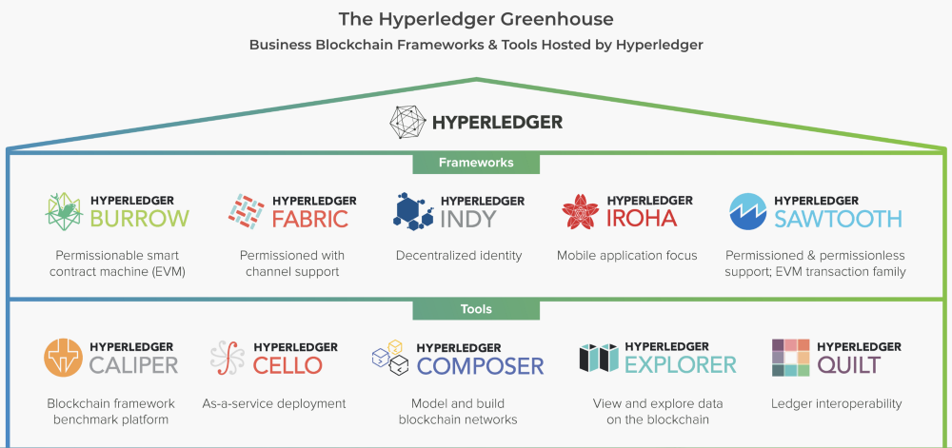
Hyperledger
Created by the IBM and Linux Foundation
Is the modular blockchain framework that has become the standard for enterprise blockchain platforms

Slide 55
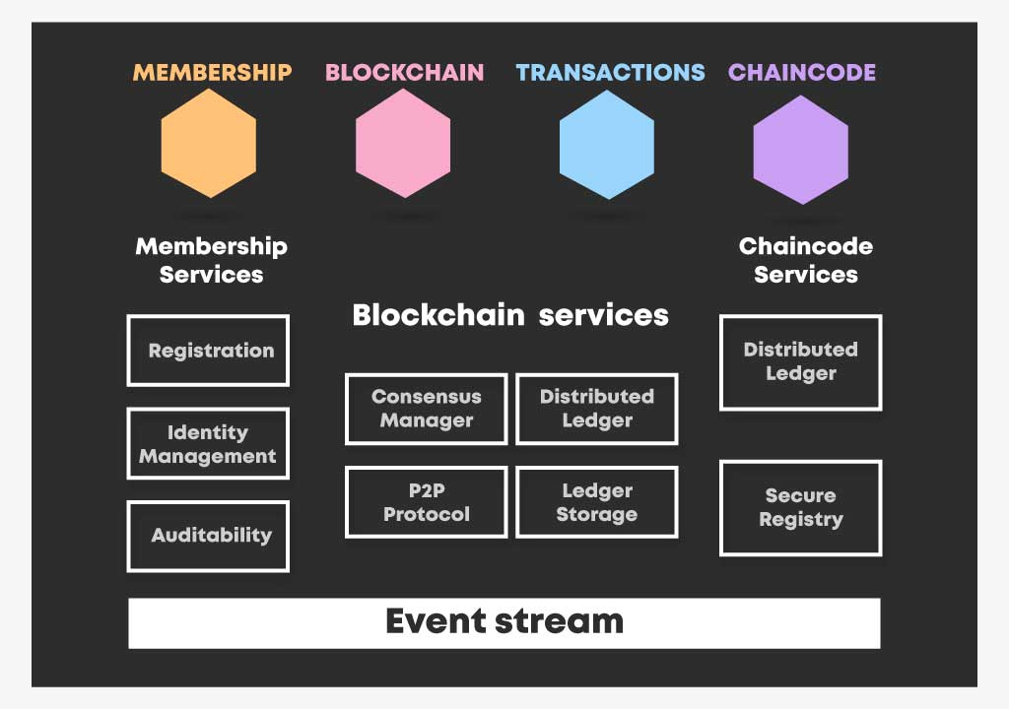

Slide 56
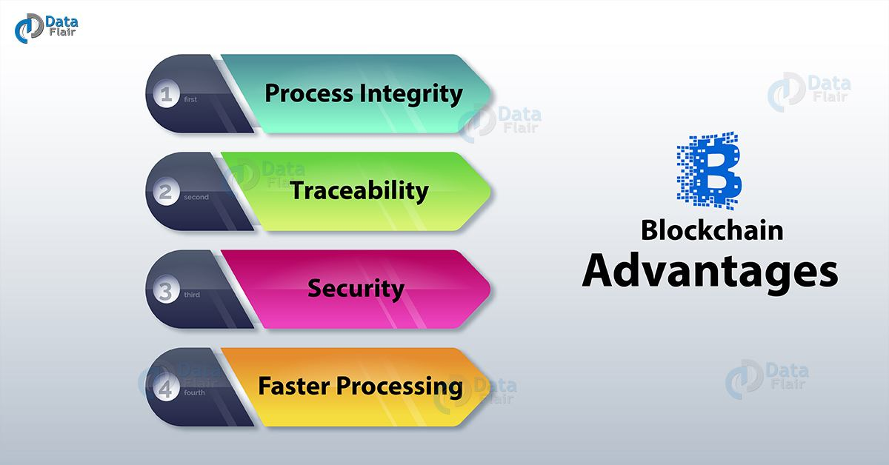
PROS

Slide 57
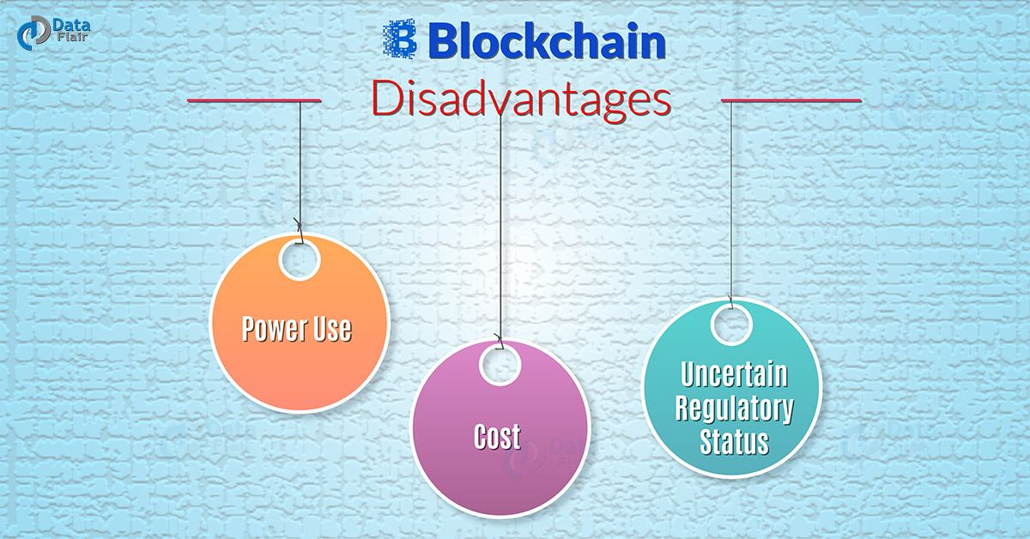
CONS

Slide 58
Where can Blockchain be used?
FITS Model: -Dr. Adrian, Lawyer
Fraud – Fraudulent operations can result in massive losses and legal problems.
Intermediaries – Agents or Regulators take up lot of your time and money.
Throughput – Govt. registrations or TXNs that take days to process.
Stable data – Authenticity of data is needed.

Slide 59
ISSUES SO FAR !!!!
An independent candidate who contested the February 21 Brihan Mumbai Municipal Corporation (BMC) poll has asked the State Election Commission (SEC) to probe what he called as ‘disappearance’ of votes cast by him and his family members
Does Amazon/ Flipkart/ Snapdeal sell duplicate product (or replica of original product)?
Food / Medicine being sold beyond expiry dates
Medical Records being tampered and medicines to be given to patients were altered.
Telecom Regulatory Authority of India (Trai) chairman, R S Sharma’s Aadhar card Issue- Hackers posted screenshots of sending Re 1 to Sharma via Aadhar enabled Payment Apps like BHIM(Bharat Interface for Money)

Slide 60
APPLICATIONS
Payment processing and money transfers
Monitor supply chains
Digital IDs
Digital voting
Real estate and land transfers
Food safety
Immutable data backup
Medical recordkeeping
Managing Internet of Things networks
Securing access to belongings

Slide 61
TOOLS
Geth & Tools - https://geth.ethereum.org/downloads/
Solc -http://solidity.readthedocs.io/en/v0.4.21/installingsolidity.html
Metamask (Chrome extension) - https://chrome.google.com/webstore/detail/metamask/nkbihfbeogaeaoehlefnkodbefgpgknn
Web3.js - https://github.com/ethereum/web3.js/
Ganache - https://github.com/trufflesuite/ganache
Truffle -https://github.com/trufflesuite/truffle
Mist - https://github.com/ethereum/mist/releases
Remix IDE - https://remix.ethereum.org/

Slide 62
Facts of The Day
According to research, Blockchain technology has managed and distributed more than $270 Billion in transactions.
The maximum no. of bitcoins that will ever exist is 21 million. The last bitcoin is expected to be mined somewhere around the year 2140. After that miners will no longer receive mining rewards.
The first ever bitcoin was used on a purchase of Pizza- May 22,2010- Bitcoin Pizza Day.
Facebook was planning to release Stable coin on WhatsApp for Indian Users. But our government made it clear that they don’t view cryptocurrencies as legit.

Slide 63
Industrial Revolution
1st – 1760s was about Mechanization – Building Machineries.
2nd – 1870s was about mass production – Stack and Store.
3rd – 1969s was Computers – Age of IT and Digitalization.
4th – Present and future – Data Driven Automation – Technologies like Blockchain, Big Data, Artificial Intelligence, 3D Printing, Augmented Reality..

Slide 64
What’s on the NEWS ??
NASA to Use Blockchain Technology For Air Traffic Management
Infosys Sets up Blockchain-Based Trade Finance Network With Seven Banks
Hollywood's First Blockchain Movie Hopes To Produce End To Piracy
IBM Beats Microsoft as Top Blockchain Technology Leader: Report
Toyota, MIT to Explore Blockchain Technology for Driverless Cars
Apple And Google Admit Ethereum App To Let Employees Prove They’ve Been Vaccinated
A 2020 And Post-Pandemic Outlook For Cryptocurrency And Blockchain Industries
Google Goes Blockchain? New Deal Opens A Door To Crypto

Slide 65




Where to Start?
DAPP UNIVERSITY
MATT THOMAS
BLOCKCHAIN AT BERKELEY
Tutorials:
Udemy
Tutorialspoint
JavaTpoint
Data Flair

Slide 66
JOB OPPORTUNITIES
Blockchain Generalist- you understand the basic concepts and are capable enough to discuss its use-cases and applications in your ecosystem
Smart Contract Developer- you understand what a Smart Contract is and how to code on it
Blockchain Developer- you understand the concepts of nodes and consensus and can build a bridge between UI and Smart Contracts
Blockchain Expert- you understand how the code of a Blockchain like Bitcoin, Ethereum network works and can code your own Blockchain network defining its rules and protocols
Miner- Strong enough to compute cryptographic hashes keeping in mind the energy being consumed.

Slide 67


